Slide 1
Where to get answers & resources for Microsoft products
Anita Mortaloni, anitase@microsoft.com
Senior Program Manager
Microsoft Office Product Group

Slide 2
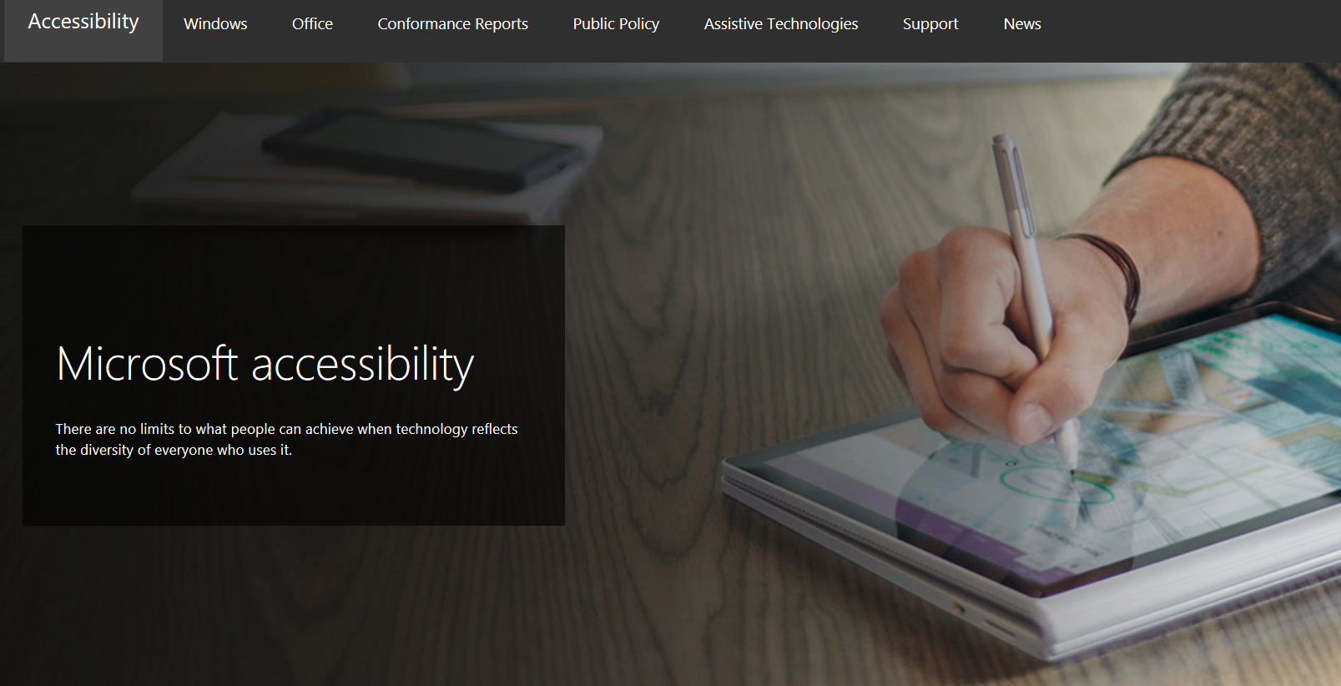
Connect with us in person today or anytime through our support and feedback channels.
Call the Disability Answer Desk: Aka.ms/AccessibilitySupport
Give suggestions in User voice: Aka.ms/AccessibilityFeedback
Message us on social media: Twitter.com/MSFTEnable

Slide 3
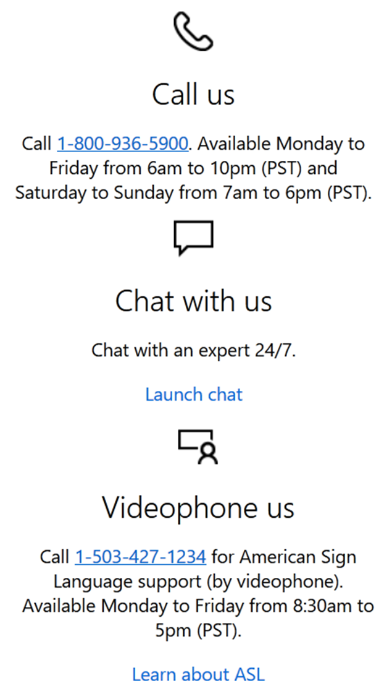
Disability Answer Desk
Free technical support for Windows and Office to any customer with a disability or person asking a question related to accessibility.
http://aka.ms/accessibilitysupport
Languages: English, Spanish, French, and American Sign Language (US Only)
Training for support representatives: Core Product training + 3rd party Assistive Technical Training + Disability Etiquette
Enterprise Disability Answer Desk also available!

Slide 4
enterprise Disability Answer Desk (eDAD)
Contact eDAD when:
You can't find accessibility compliance documentation
You want to report an accessibility issue on a Microsoft Product
You have an AT issue with a Microsoft Product
You need accessibility best practice guidance you can't find online
Support is available from 8am – 5pm PT, Mon-Fri
Simply email eDAD@Microsoft.com
Agents inc. Native JAWS, Braille, and Magnification users

Slide 5
eDAD facts
eDAD has successfully answered nearly 2,000 customer inquiries
eDAD is a trusted advisor used by Universities, Fortune 500 companies, Government and NGOs
Most customer cases resolved by providing compliance documentation, online how-to’s, and technical posts
40% of eDAD case volume are screen reader issues
4/5 of those issues related to JAWS specifically
Low Vision issues are on customization
Customers want to customize contrast, color schemes in general, and text size

Slide 6
eDAD wins
Veterans Affairs
Supplying over 40 requested VPAT reports
Helping to drive improvements into CRM, SSRS, Office 365
Working with VFO on behalf of the VA to ensure functionality for mutual customers when issues were found with JAWS on Microsoft products
DHS
Helping to drive improvements into VS, CRM, SfB, and Microsoft Virtual Academy courses
DOJ
Providing numerous accessibility how-to documents for SharePoint, OneDrive, SfB, Word, Excel, and PowerPoint - now all easily accessed on the Office Accessibility Center

